Slide 1
Entity Framework Core and what do you need to know to use it
Andriy S'omak, Beetroot Solution Team • 05/13/2021

Slide 2
Topics
What are EF Core and its purpose;
EF Core features overview;
LINQ-To-Entities overview;
Optimization and typical mistakes using Entity Framework;
Debugging of queries.

Slide 3
What are EF Core and its purpose?

Slide 4
What is Entity Framework Core?
Entity Framework Core (EF Core) is the latest version of the Entity Framework from Microsoft. It has been designed to be lightweight, extensible and to support cross platform development as part of Microsoft's .NET Core framework. It has also been designed to be simpler to use, and to offer performance improvements over previous versions of Entity Framework.

Slide 5
Entity Framework is Object-Relational Mapper (ORM)
Strong typing;
Map a domain model to database objects;
Create databases and maintain the schema in line with changes to the model;
Generate SQL and execute it against the database;
Manage transactions;
Keep track of objects that have already been retrieved.

Slide 6
Entity Core Architecture
Entity Framework
ORM Interface
LINQ To Entities
Entity Data Model
Application
Object Services
Conceptual Model
EntityClient Data Provider
Mapping
Database
Storage Model
ADO.NET

Slide 7
LINQ-To-Entities Query Execution Flow
Application
LINQ Query
Objects
Entity Framework
Expression Tree
SQL
Materialization
ADO.NET
Command Object
Data Reader
Database
Execution
Results

Slide 8
EF Core Database Providers
SQL Server 2012 onwards
SQLite 3.7 onwards
EF Core in-memory database (for testing purposes only)
Azure Cosmos DB SQL API
PostgreSQL
MySQL, MariaDB
Oracle DB 11.2 onwards
MySQL 5 onwards
Oracle DB 9.2.0.4 onwards
PostgreSQL 8.0 onwards
SQLite 3 onwards
Firebird 3.0 onwards
Db2, Informix

Slide 9
2. Entity Framework Core features overview

Slide 10
Cross-platform: EF Core is a cross-platform framework which can run on Windows, Linux and Mac.
Modelling: EF creates an Entity Data Model based on entities with get/set properties of different data types. It uses this model when querying or saving entity data to the underlying database.
Querying: EF allows us to use LINQ queries to retrieve data from the underlying database. The database provider will translate this LINQ queries to the database-specific query language (e.g. SQL for a relational database). EF also allows us to execute raw SQL queries directly to the database.
Change Tracking: EF keeps track of changes occurred to instances of your entities (Property values) which need to be submitted to the database.
Saving: EF executes INSERT, UPDATE, and DELETE commands to the database based on the changes occurred to your entities when you call the SaveChanges() method. EF also provides the asynchronous SaveChangesAsync() method.

Slide 11
Concurrency: EF uses Optimistic Concurrency by default to protect overwriting changes made by another user since data was fetched from the database.
Transactions: EF performs automatic transaction management while querying or saving data. It also provides options to customize transaction management.
Caching: EF includes first level of caching out of the box. So, repeated querying will return data from the cache instead of hitting the database.
Built-in Conventions: EF follows conventions over the configuration programming pattern, and includes a set of default rules which automatically configure the EF model.
Configurations: EF allows us to configure the EF model by using data annotation attributes or Fluent API to override default conventions.
Migrations: EF provides a set of migration commands that can be executed on the NuGet Package Manager Console or the Command Line Interface to create or manage underlying database Schema.

Slide 12
EF Core Approaches
Code First
Database First
Entities
Database
Entity Framework
Entity Framework
Entities
Database

Slide 13
What is DbContext and DbContextOptions
The DBContext is heart of the Entity Framework. It is the connection between our entity classes and the database. The DBContext is responsible for the database interactions like querying the database and loading the data into memory as entity. It also tracks the changes made to the entity and persists the changes to the database.
The DBContext requires the DbContextOptions instance in order to perform any task. The DbContextOptions instance carries configuration information such as the database providers to use, connection strings and any database related configuration information.

Slide 14
DbContext functions
Managing Database connection
Configuring Model & relationships
Querying & Saving data to the database
Change Tracking
Transaction Management

Slide 15
Understanding Entity and DbSet<TEntity>
The DbSet represents the collection of all entities in the context. Every model must expose the DbSet property to become part of the Context and managed by it. We use the DbSet to Query, Insert, Update & Delete entities.
An entity in Entity Framework is a class that maps to a database table. This class must be included as a DbSet<TEntity> type property in the DbContext class. EF API maps each entity to a table and each property of an entity to a column in the database.

Slide 16
DbSet<TEntity> basic operations
Adding the entity (Add, AddRange)
Retrieving an entity (Find, First, Single)
Retrieving multiple entities (Select, FromSql)
Modifying an entity (Update, UpdateRange)
Deleting an entity (Remove, RemoveRange)
Attaching to an Context (Attach, AttachRange)

Slide 17
Change Tracker & EntityState
Performs DbContext.SaveChanges();
Entity
EntityState.Detached
Database
DbContext
INSERT
Entity
EntityState.Added
UPDATE
Entity
EntityState.Modified
DELETE
Entity
EntityState.Deleted
Entity
EntityState.Unchanged

Slide 18
Model configuration & relationships
What is the best approach?
Data Annotation
Fluent API
Mixed

Slide 19
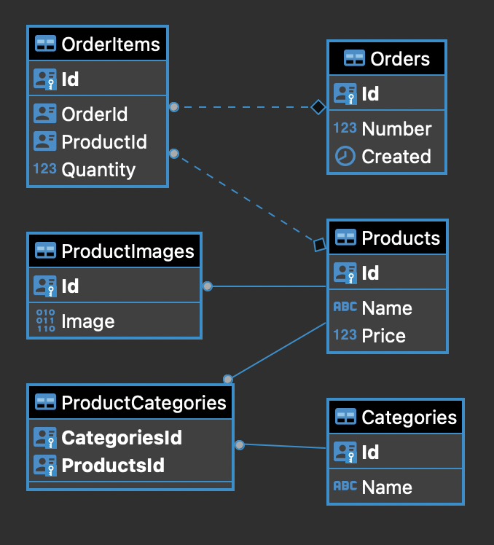
Entity basic relationships
One To Many
One To One
Many To Many

Slide 20
Transaction Management
By default each DbContext.SaveChanges are wrapped in a single transaction.
You can control the transactions better by using DbContext.Database API. You can Begin transaction, Commit, and Rollback transactions

Slide 21
EF Core Migrations
Entity Models + DbContext
generates
generates
Migration Code
SQL Script
updates
Database

Slide 22
3. LINQ-To-Entities overview

Slide 23
LINQ Syntax
Query Syntax
var querySyntaxResult = from p in context.Products
where p.Name.Contains("Product 1) select p;
Method Syntax
var methodSyntaxResult = context.Products.Where(x => x.Name.Contains("Product 1"));

Slide 24
EF Core and LINQ to Entities Query Methods (Operators)
Sequence queries
Where, OfType
Mapping (projection): Select
Generation: DefaultIfEmpty
Grouping: GroupBy
Join: Join, GroupJoin, SelectMany, Select
Concatenation: Concat
Set: Distinct, GroupBy, Union, Intersect, Except
Convolution: Zip
Partitioning: Take, Skip
Ordering: OrderBy, ThenBy, OrderByDescending, ThenByDescending
Conversion: Cast, AsQueryable
Value queries: return a single value
Element: First, FirstOrDefault, Last, LastOrDefault, Single, SingleOrDefault
Aggregation: Count, LongCount, Min, Max, Sum, Average
Quantifier: All, Any, Contains

Slide 25
IQueryable Interface
The IQueryable interface inherits the IEnumerable interface so that if it represents a query, the results of that query can be enumerated. Enumeration causes the expression tree associated with an IQueryable object to be executed. The definition of "executing an expression tree" is specific to a query provider. For example, it may involve translating the expression tree to an appropriate query language for the underlying data source. Queries that do not return enumerable results are executed when the Execute method is called.

Slide 26
4. Optimization and typical mistakes using Entity Framework

Slide 27
Optimization and typical mistakes
The ObjectContext instance has been disposed and can no longer be used for operations that require a connection;
Forgetting about projections. Select only data you needed;
Forgetting to add indexes;
Do not ToList() before filtered iteration;
Related collections are not IQueryables;
Avoid instantiating unnecessary ObjectContext-instances;
Using Include. Cartesian Explosion. AsSplitQuery;
Lazy Loading mostly an issue;
The N+1 Problem;

Slide 28
Optimization and typical mistakes
First or FirstOrDefault?;
Ignoring the way your ORM translates your operations to queries;
Do not use Change tracking for read-only queries, use AsNoTracking;
Batch Operations. Do not forget that Entity Framework does CRUD operations one-by-one;
Use caching of LINQ expressions. Constants in expressions;

Slide 29
5. Debugging of queries

Slide 30
Questions Time

Slide 31
Thank you very much for your attention ;)

